Slide 1
Discussion 0: Introduction
Section 129
CS61A Fall 2018

Slide 2
Welcome to CS61A!
GSI: Jason Zhou
Section 129B/C: Wed/Fri @ 11:30 AM - 1:00 PM @ Soda 273/405
Contact
jasonzhou@berkeley.edu w/ [Section 129] in title
Piazza private post w/ [Section 129] in title
Section 129 Resources
jasonxzhou.com/teaching
Office Hours
CS61A: TBD ASAP
Eta Kappa Nu (hkn.mu): TBD in ~2 weeks

Slide 3
Announcements
Today: Lab 00 “tech support” OH 4-7pm @ 611 Soda
Wednesday 8/29: First lab
Thursday 8/30: Homework 01 Due
Thursday 9/6: Project 01 Due

Slide 4
Agenda
Lost on the Moon
61A Tips & Strategies
Q&A

Slide 5
1
Lost on the Moon

Slide 6
1
Lost on the Moon
1 | Two 100-pound tanks of oxygen
2 | 5 gallons of water
3 | Stellar map
4 | Food concentrate
5 | Solar-powered FM receiver-transmitter

Slide 7
1
Lost on the Moon
6 | 50 feet of nylon rope
7 | First-aid kit
8 | Parachute silk
9 | Self-inflating life raft
10 | Signal Flares

Slide 8
1
Lost on the Moon
11 | Two .45 caliber pistols
12 | One case of dehydrated milk
13 | Solar-powered portable heating unit
14 | Magnetic compass
15 | Box of matches

Slide 9
1
Lost on the Moon
0 - 25 | Excellent
26 - 32 | Good
33 - 55 | Fair
56 - 70 | Oh well
71 - 112 | Oops

Slide 10
1
Lost on the Moon
Team >> Individual
Collaborative environment
Making new friends/potential project partners for 61A

Slide 11
2
61A Tips & Strats
Use Piazza for everything
Best way to contact course staff
Pooled coursewide resource for ~2k people
Fast response time
Manage your time well
Stay caught up on lectures
Start projects early
Plan ahead for office hours
Struggle through practice midterms
Exam problems significantly more challenging than most lab/hw/dis problems
Print out past midterms, work through them on paper by hand
Go for quantity at first; digest and understand many exam-level problems
Ask questions

Slide 12
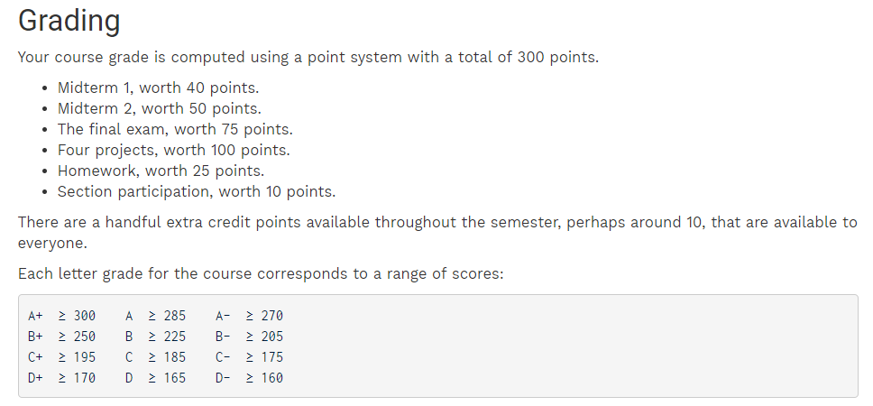
2

Slide 13
3
Q & A
Logistics/Policy?
Course Content?
Exams?

Slide 14
Attendance
links.cs61a.org/jasonz-attendance

